Slide 1

NỘI QUY TIẾT HỌC
GIƠ TAY
KHI CÓ Ý KIẾN
NGỒI ĐÚNG
TƯ THẾ
ÂM LƯỢNG
MỨC 0
4
3
90
2
1

Slide 2

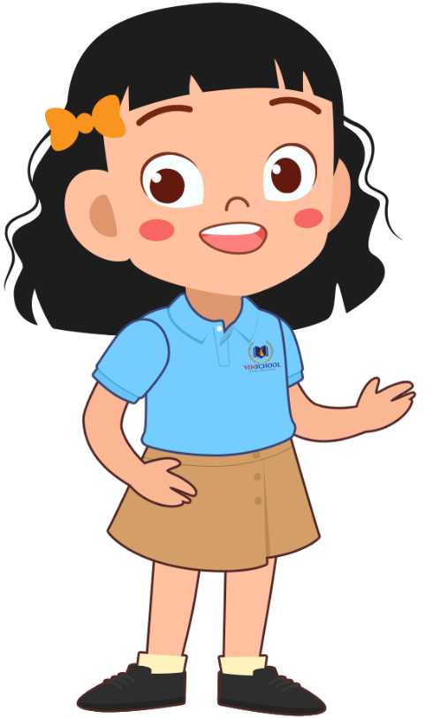
Mình đã được làm quen với phần mềm Tynker
Thật tuyệt
Notes:
Trong tiếng Việt có những dấu thanh nào?

Slide 3

THỰC HÀNH 2
TIN HỌC 1
CHỦ ĐỀ: LẬP TRÌNH VỚI TYNKER
Vũ Thị Thi
Notes:
Con cần làm gì để gõ được các dấu thanh?

Slide 4
MỤC TIÊU BÀI HỌC
1
2
Trình bày được ý nghĩa, vị trí và cách dùng của nhóm lệnh Animation
Vận dụng nhóm lệnh Animation để tạo sản phẩm

Slide 5
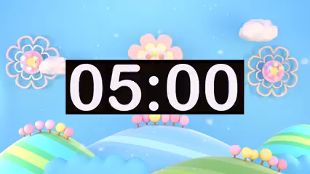



01
Ai nhanh hơn
Tiêu chí thành công
HS trình bày được ý nghĩa của nhóm lệnh Animation
HS trình bày được cách dùng các lệnh tạo hiệu ứng cho nhân vật
Hình thức: Trò chơi cá nhân

Slide 6
02
AI LÀ CHUYÊN GIA
Hình thức: Cá nhân

Slide 7
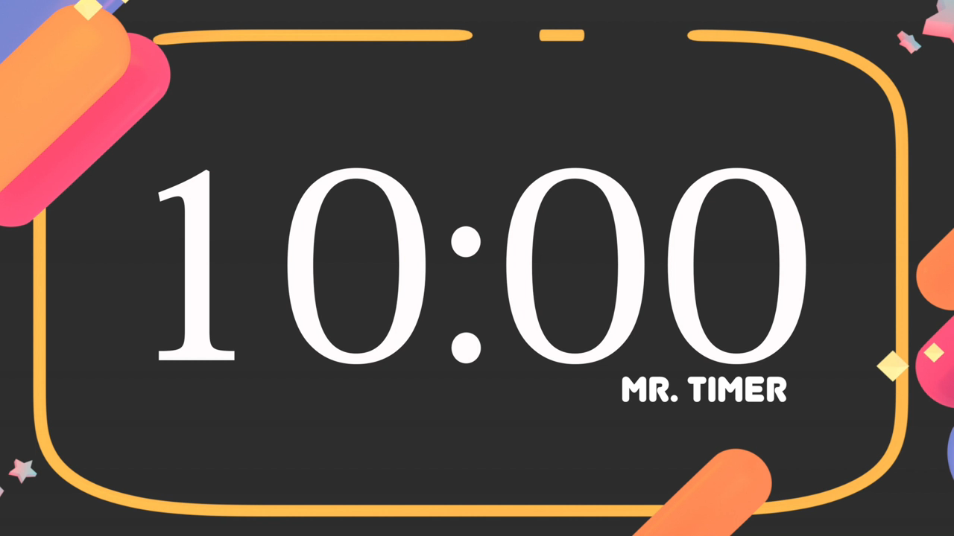













THỰC HÀNH
Đăng nhập Tynker
Tạo một dự án mới
Tạo sân khấu Vinschool Got Talent cho nhân vật biểu diễn
TIÊU CHÍ THÀNH CÔNG
HS đăng nhập được tài khoản
HS tạo được dự án mới
HS tạo được sân khấu Vinschool Got Talent
4. Thêm nhân vật và lập trình cho nhân vật biểu diễn

Slide 8

TRÌNH BÀY SẢN PHẨM
Yêu cầu: mỗi nhóm chọn một sản phẩm đẹp nhất để trình bày trước lớp.
Tiêu chí:
1. Sản phẩm có màu sắc đẹp, bắt mắt
2. Nhân vật thực hiện thao tác nhảy múa
Notes:
Thay đổi màu cho SmartArt ntn?

Slide 9

GÓC CHIA SẺ
01 điều con đã học được?
01 điều con cần làm tốt hơn?

Slide 10


Con đánh giá tiết học
hôm nay như thế nào?

Slide 11
#5. Capitalize the titles of written or performed works like books or movies
Titles of artistic works also get capitalized!
Cloudy with a Chance of Meatballs is a book that was later made into a movie
Cloudy with a Chance of Meatballs is a book that was later made into a movie
Here you could write your exercise

Slide 12
#6. Many words only get capitalized depending on how they are in the sentence
Capitalize this... | Only if...
north, south, east, west | ...you use it as a specific place and not a direction
mom, dad, aunt, grandma, etc. | ...you can replace the word with the relative’s name and still makes sense
mountain, desert, river, ocean, etc. | ...it is a part of its actual name, such as Mojave Desert
earth | ...you’re talking about the planet Earth
college, school, library, university, etc. | ...you use it with the actual name, such as Hassler Elementary School

Slide 13
02
Comma Rules
You could enter a subtitle here if you need it

Slide 14
Awesome words

Slide 15
#1. Use a comma before a conjunction when combining two complete sentences
I need to go to the grocery, and my sister needs to go to the library
{I need to go to the grocery}, {and my sister needs to go to the library}
Here you could write your exercise

Slide 16
#2. Use commas to separate three or more words or phrases
I need to finish my homework, take out the dog, and help Mom with the dishes
{I need to finish my homework}, {take out the dog}, {and help Mom with the dishes}
Here you could write your exercise

Slide 17
#3. In dialog, use a comma to separate the narrator from the speaker
“I want to study medicine when i grow up,” Maria declared.
Derek responded, “You do?”
“{I want to study medicine when i grow up},” {Maria declared.}
{Derek responded}, “{You do?}”
Here you could write your exercise

Slide 18
#4. Use a comma (or two) when you directly mention a person
Julia, please hand me that box of crayons. Will You, John, hand me the pencils?
{Julia}, please hand me that box of crayons.
Will You, {John}, hand me the pencils?
Here you could write your exercise

Slide 19
#5. Use a comma to separate an introductory phrase from the sentence
After the big game, the baseball team celebrated their win
{After the big game}, {the baseball team celebrated their win}
Here you could write your exercise

Slide 20
#6. Use a comma after a transition word or phrase
Finally, mix the chocolate syrup and the milk. After you’re done, enjoy your tasty drink
{Finally}, mix the chocolate syrup and the milk. {After you’re done}, enjoy your tasty drink
Here you could write your exercise

Slide 21
04
Dialogue Rules Reference
You could enter a subtitle here if you need it

Slide 22
Dialogue Rules Reference
#1. Quotation Marks
#2. Commas in quotation marks
Mercury is the closest planet to the Sun
Venus has a beautiful name, but it’s hot
#3. ? and ! in Quotation Marks
#4. Examples
Despite being red, Mars is a cold place
It’s the farthest planet from the Sun

Slide 23
#1. Use quotation marks around the words that someone is actually saying
“This is so much fun!,” said Jenna
“This is so much fun!,” said Jenna
Here you could write your exercise

Slide 24
#2. Commas are used to separate the speaker from the narrator
“This is my favorite toy,” said Sally. Charles responded, “I prefer my toy car!”
“This is my favorite toy,” said Sally.
Charles responded, “It’s so cute!”
Here you could write your exercise

Slide 25
#3. You can replace a comma with a question mark or an exclamation point
“What are you doing?” asked Mom. Jackson looked up, “having fun!” he said
“What are you doing?” asked Mom.
Jackson looked up, “having fun!” he said
Here you could write your exercise

Slide 26
#4. Examples
N = Narrator S= Speaker
Structure | Example
S | “I like the summer.”
S - N | “I like the summer,” said Maria.
N - S | Maria said, “I like the summer.”
S - N - S | I really like summer,” Maria said and then added, “because it’s time to swim!”

Slide 27
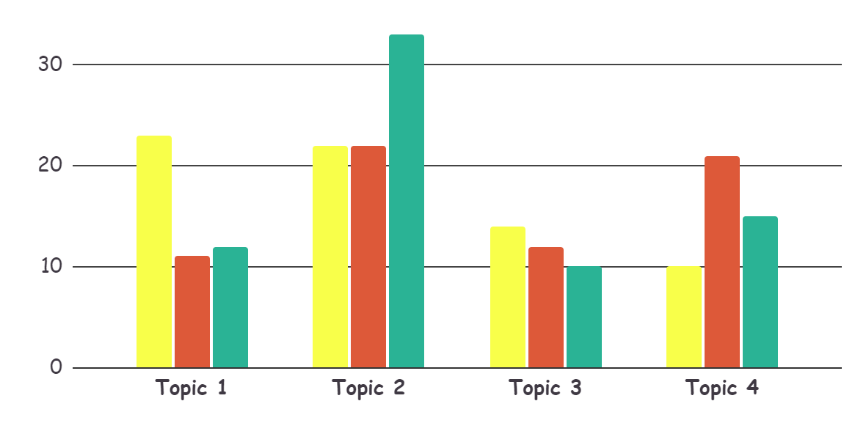
This is a graph
30% - Venus
Venus has a
beautiful name
20% - Mercury
It’s the closest planet to the Sun
50% - Mars
Despite being red, Mars is a cold place
To modify this graph, click on it, follow the link, change the data and paste the resulting graph here, replacing this one

Slide 28
These are percentages
Mercury
Saturn
Jupiter
60%
75%
25%
Mercury is the smallest planet of them all
Saturn is composed of hydrogen and helium
Jupiter is the biggest planet of them all

Slide 29
This is an infographic
60%
15%
Mars
Venus
Despite being red, Mars is a cold place
Venus has a beautiful name, but it’s hot
15%
Mercury
Mercury is the closest planet to the Sun

Slide 30
This is a map
Venus
Venus has a
beautiful name
Mercury
It’s the closest planet to the Sun
Mars
Despite being red, Mars is a cold place

Slide 31
A timeline always works well
day 2
day 4
day 1
day 3
Venus is terribly hot and has high temperatures
Jupiter is the biggest planet of them all
Mercury is the smallest planet of them all
Saturn is composed of hydrogen and helium

Slide 32
4,498,300
Big numbers catch your audience’s attention

Slide 33
333,000.00
24h 37m 23s
386,000 km
earths is the Sun’s mass
is Jupiter’s rotation period
is the distance between Earth and the Moon

Slide 34
Our team
Jenna Doe
John Patterson
Helena White
You can replace the image on the screen with your own
You can replace the image on the screen with your own
You can replace the image on the screen with your own

Slide 35
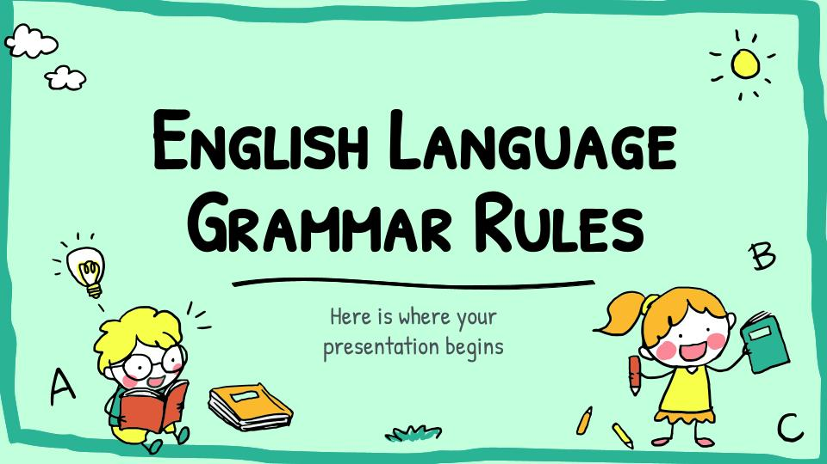
Desktop Software
You can replace the image on the screen with your own work. Just delete this one, add yours and center it properly

Slide 36
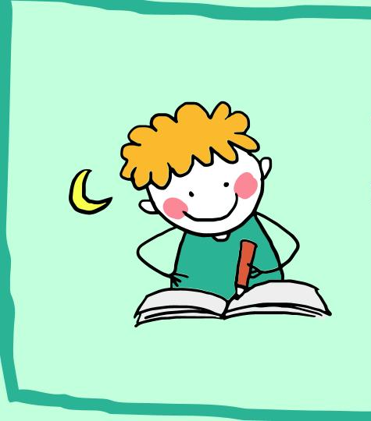
Tablet app
You can replace the image on the screen with your own work. Just delete this one, add yours and center it properly

Slide 37
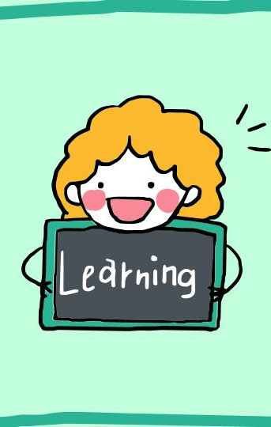
Mobile web
You can replace the image on the screen with your own work. Just delete this one, add yours and center it properly

Slide 38
Thanks!
Do you have any questions?
youremail@freepik.com
+91 620 421 838
yourcompany.com
Please keep this slide for attribution

Slide 39
Alternative resources

Slide 40
#4. Capitalize places including addresses, cities, states, countries, and continents
Capitalize abbreviations of these places too!
I live on Main Street in Houston, Texas. Texas is a state in the United States of America
I live on Main Street in Houston, Texas. Texas is a state in the United States of America
Here you could write your exercise

